Slide 1
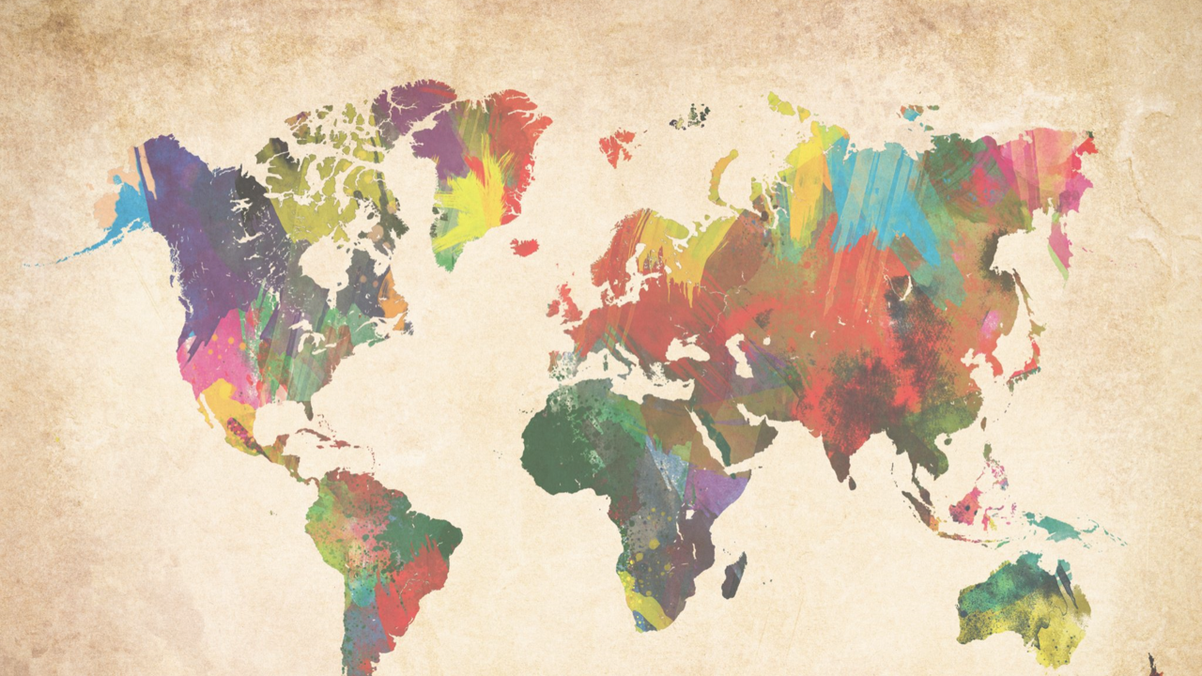
Lexical flexibility: Expanding the empirical coverage
Daniel W. Hieber
University of California, Santa Barbara
danielhieber.com
Linguistics Colloquium, UC Santa Barbara, November 12, 2020
Notes:
Thanks for coming

Slide 2
Lexical flexibility
The use of a word in more than one discourse function (reference, predication, modification) with no overt derivational morphology.
In other words …
The use of a word for more than one part of speech (noun, verb, adjective).
(bad definition)

Slide 3
English (Indo-European > Germanic)
N: And the spots of paint would change every hundred degrees.
V: One story does come to mind though where you painted the foundation coating on the house and got tar all over you.
A: And it happened to be one of the rare paint jobs.

Slide 4
Mandinka (Mande > Manding)

Slide 5
Mundari (Austroasiatic > Munda)

Slide 6
Nuuchahnulth (Wakashan > Southern Wakashan)

Slide 7
Quechua (Quechuan)

Slide 8
Tongan (Austronesian > Polynesian)

Slide 9
Central Alaskan Yup’ik (Eskimo-Aleut > Yup’ik)

Slide 10
Acknowledgments

